Slide 1

Name: Smeet Vaghela | Enrollment: 230840131131
Stream: Computer Science & Engineering | College: R. N.G. Patel Institute Of Technology

Slide 2

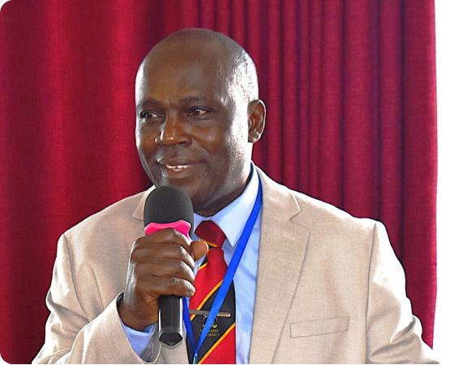
Key Insights & SDG 17
SDG 17 (Partnerships for the Goals) is the foundation for achieving all other sustainable targets by pooling global resources, technology, and capital.
The Hidden Cost of Tech: Documentaries reveal that global data centers consume millions of gallons of water and vast amounts of electricity daily to train models.
Systemic Change: True sustainability requires aligned government policies, cross-border cooperation, and transparent tracking of corporate environmental footprints.

Slide 3






Interactive Tool Glances
En-ROADS Simulator
Ecological Footprint
An interactive climate policy model that allows users to test strategies (like carbon pricing or energy efficiency) to see real-time impacts on global temperature.
A calculator that measures personal resource consumption and compares it against the Earth's biocapacity, illustrating our individual overshoot.
EcoTransit World
AI & Green Media
A comprehensive tool used to calculate the environmental impacts and precise carbon emissions of global freight and transport systems.
Leveraging tools like Nando AI for rapid content creation and following channels like Gen-E Media to spread vital awareness about green technology.

Slide 4
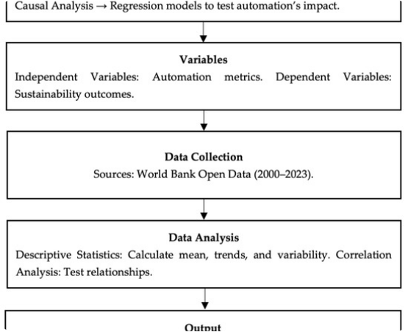
Green Skilling & AI's Impact
Green Skilling: Equipping the workforce with the knowledge and technical abilities to transition to a cleaner economy (e.g., renewable energy maintenance, sustainable agriculture).
The Good of AI: AI optimizes smart grids, enhances environmental monitoring via satellite, and streamlines global supply chains to reduce waste.
The Bad of AI: The massive compute power required to train generative AI models creates a massive carbon footprint, exacerbates e-waste, and demands excessive water cooling.

Slide 5
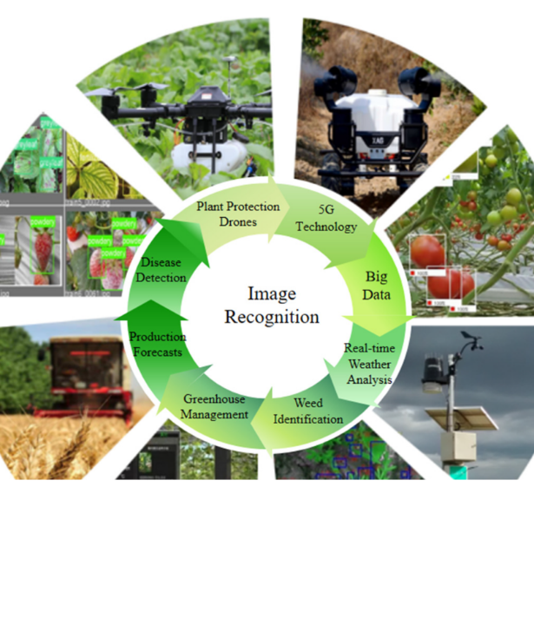
Capstone Project
Eco-Grid AI: An intelligent energy distribution model prioritizing local renewable sources for communities.
Predictive Forecasting
Automated Load Balancing
Community Impact (SDG 17)
Eco-Grid AI operates on the theory of intelligent load balancing. It uses machine learning to predict weather patterns and energy usage, automatically routing local renewable power to immediate areas of demand. This eliminates waste and creates a self-sustaining, zero-emission community microgrid.
4. Agri-Smart Network: Combining IoT sensors and AI to optimize water and fertilizer usage in sustainable agriculture.

